Slide 1
Lecture 1
1.1 Why Urban Science? What is Urban Science?
IUS Chapter1
©Luís M. A. Bettencourt 2023
IUS 1.1 What is Urban Science?

Slide 2
What should cities be like?
Notes:
This is a prompt to unpack earlier normative ideas in urban planning and policy, which were more based on the ideas of a few people than on reality. And that have arguably done more harm than good.

Slide 3
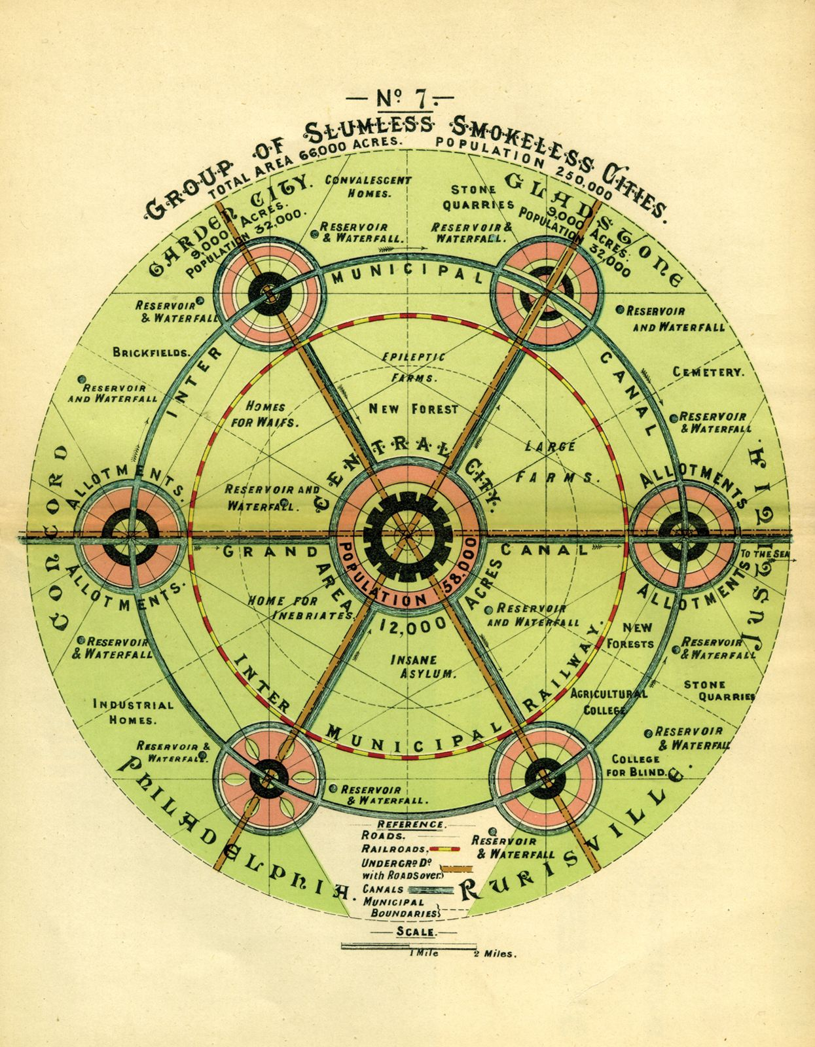
Garden Cities of To-morrow
Ebenezer Howard 1902
EcoUtopia
where are the people?
mostly utopian, moralistic land use scheme
with strong prescriptive “zoning”, including segregated space for the “inebriates”
Notes:
This is completely crazy, but gives a sense of uncritical, moralistic planning; note insane asylum, epileptic farm and so on…

Slide 4
Industrial Utopia
population density in the wrong places
public spaces given to cars
uniformity and drabness in the name of efficiency
Le Corbusier: Ville Radieuse 1924-33
Notes:
This is of course very famous. 20th century modernist planning ideas based on efficiency and “circulation” but without any consideration for people, development, etc : The city as a machine, as Kevin Lynch once called it.

Slide 5

https://www.neom.com/en-us/regions/theline
Notes:
This is a present urban utopia in Saudi Arabia: It’s supposed to be a “linear” city: I’ll let you discuss what is wrong with that …

Slide 6
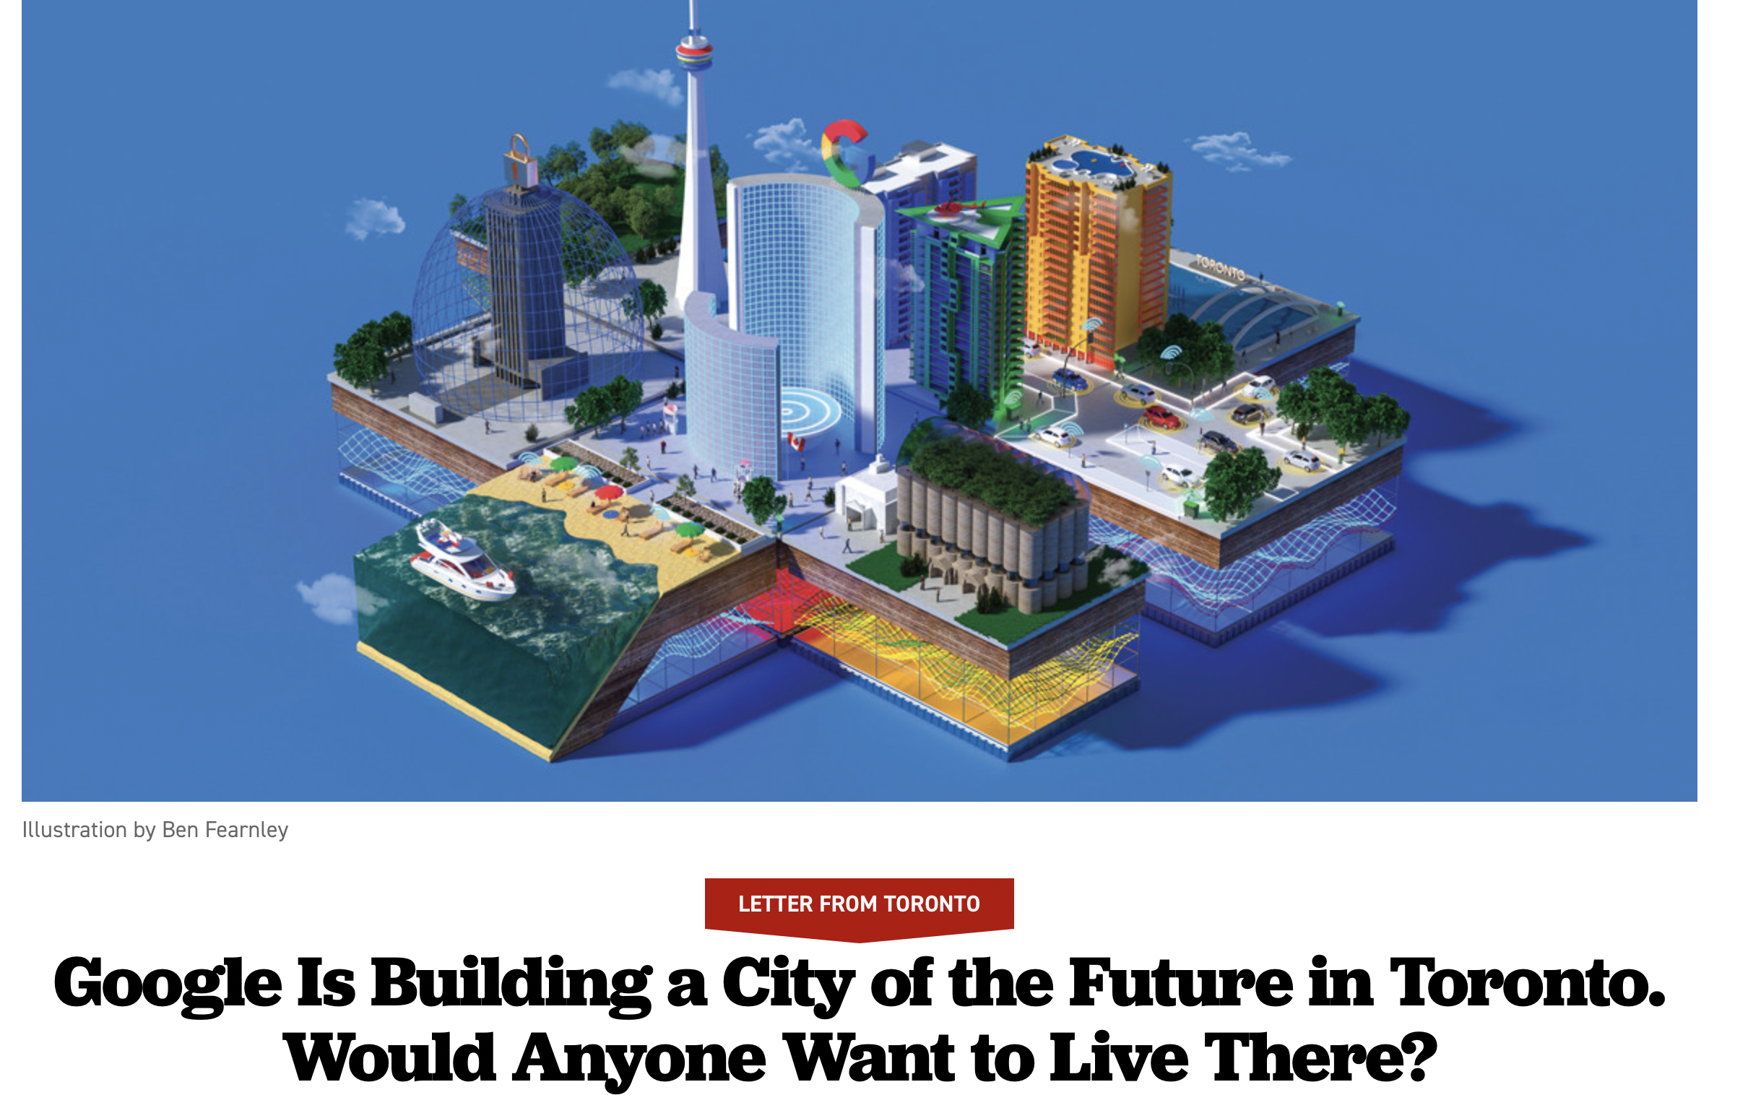
https://www.politico.com/magazine/story/2018/06/29/google-city-technology-toronto-canada-218841/
Notes:
And technoutopias, or (old versions) of smart cities: what is wrong with these?

Slide 7
What are cities really like?

Slide 8
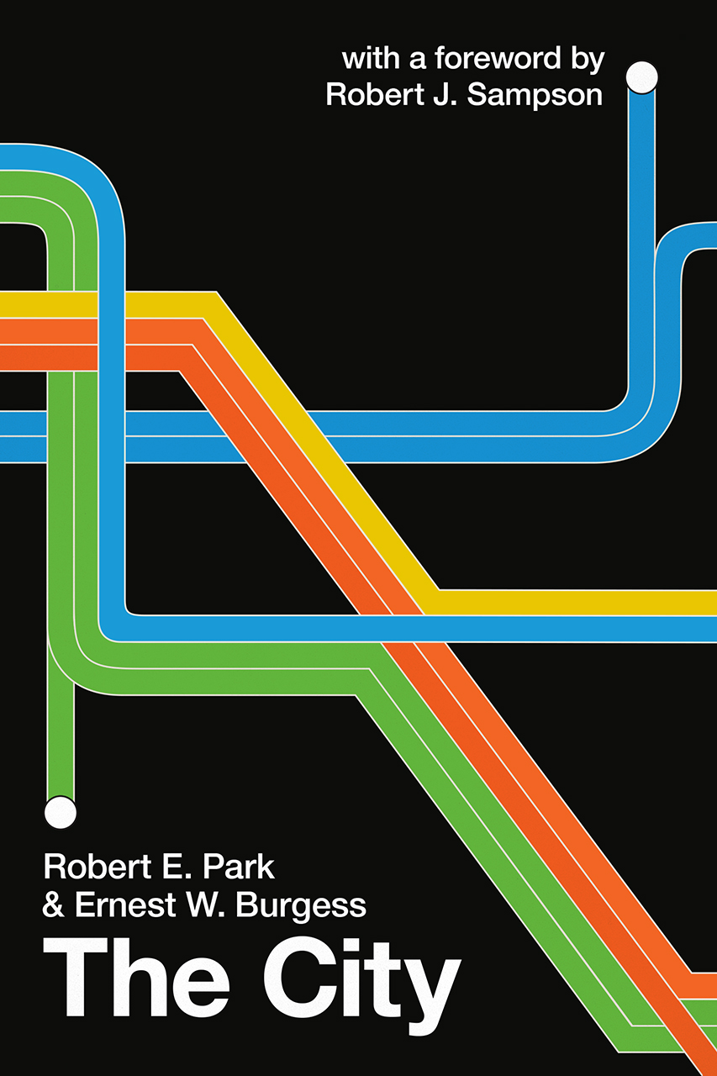
The city is not merely a physical mechanism and an artificial construction.
It is involved in the vital processes of the people who compose it;
it is a product of nature, and particularly of human nature.
- R. E. Park, The City 1925
Notes:
This is a quote from the famous book. The idea here is that of the city as a “Natural Phenomenon”, that needs to be studied and understood via scientific methods that respect the phenomenon before us. Instead of stating what we think the city should be, we should investigate what it is with rigorous methods.
Park and Burgess were sociologists, but Park had a deep interest in Psychology and Society in general, his essay in the book is really a list of questions, many of which (almost 100 years ago) still ring fresh.

Slide 9
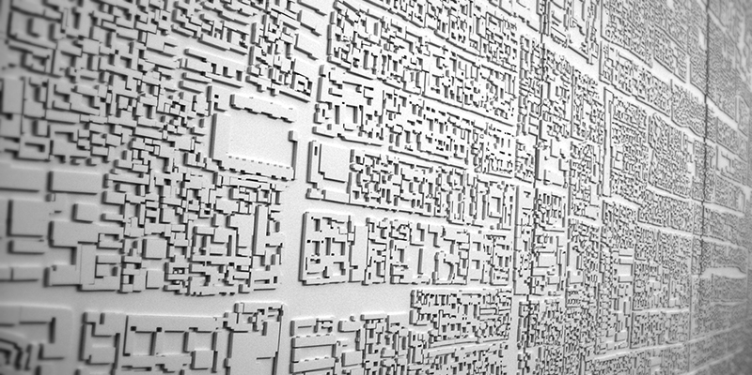
settlements in history
lots of data
computing
Social Equity
Digital Revolution
Urban Practice
Urban Science
Urban Analytics
Climate Change
Universal Urbanization
comparative analysis
future cities
Notes:
A scientific approach to cities (Urban Science, or a Science of Cities) has gained strength in the last 20 years, because we can observe urbanization everywhere in the world (comparative analysis), creating many diverse cities, across different cultures, geographies, economic organization etc. Also because of have a lot more and better data. Urban science is generalizable knowledge and must predict features of cities present, past and future. Along with urban science, there has been a growth in urban analytics (practical uses of data to manage cities) and Practice in terms of a more person-centric view of life in cities.

Slide 10
The best way to know a thing is in the context of another discipline.
- Leonard Bernstein, Norton Lectures (1976).
About this course:
- This is a course about Urban Science, about what we can know about cities that is generalizable.
observable processes or signals that we can experience or measure across history
and throughout the world despite different geographies, cultures, levels of development and so on.
This is also a course about bringing together different ways of thinking.
To create a body of knowledge - concepts, theory and a set of mathematical models- that can explain and generate the complexity and open-endedness of cities
IUS Preface

Slide 11
Three Objections to Scientific Approaches to Cities
1. Complexity: Cities are made of so many decisions, accidents, they are so rich in history
“There can be no theory”, no set of mathematical models that does Cities justice.
Not true. Example: Biology is a science of structure, systems and natural histories.
2. Science and Data lead to Oppressive Social Policy:
Not true: These are misuses of science and data in value laden policy:
Recall that data does not give you solutions: “the past is not the right answer”.
Science is not authority: it is critical thinking with facts; it stands in opposition to dogma.
3. Math and Science entail a loss of freedom and humanity:
Not true: science has given us new freedoms: going to the moon, health, longer lives…
Math in cities expresses mundane constraints: Space, Time, Energy, Money.
Urban Science leaves freedom for everything else: free will, agency, preferences, accident
This means we will have to construct a Statistical Theory of Cities:
away from classical Social Sciences based on either simplistic “rationality” or structural determinism
Notes:
This is to display certain myths about science, especially for people trained in the humanities and in critical perspectives in the social sciences in the last generation.

Slide 12
Uniqueness and Generality Both!
A Person is Unique; A City is Unique
Being special is always a relative state
Any sense of uniqueness requires a background pattern of general mechanisms and facts against which it can be appreciated.
This background pattern is set by averages: over populations and time. We can average more or less.
Such average pattern is not a description of – or a model for – individual behavior!
We will use this analytical device of zooming in and out via averaging in different ways to show how each city and every one of its people is the result of the aggregation of many choices, accidents and influences from their compounded joint history.
Interestingly, the resulting statistical properties of cities will be more than the sum of these parts.
Notes:
The relationship between general aspects of cities and features of each situation is worth discussing a bit.

Slide 13
Why Urban Science?
Science as a process is uniquely good at creating insights that vastly transcend our daily experience and intuitions.
This allows us ultimately to escape the mental and institutional traps we live in today, especially in practice and policy, and helps us imagine – but does not determine! – how we may build a better tomorrow.
This approach is more important in the context of urban science because cities feel so familiar to us all.
Science is not a substitute for other practices of scholarship, especially in the humanities, but it does have its unique and powerful role to play in a fast urbanizing world, where many similar challenges recur.
Notes:
We will see that there are many things we will discover about cities that are not intuitive, or expected. We can only get to them by keeping an open mind and paying att

Slide 14
Features of Urban Science
Three main ingredients:
Interdisciplinary integration and synthesis,
A rich and expanding empirical basis (data) and methods across scales,
Reflecting and honoring diverse human experiences in different contexts.
This creates a scientific culture for urban science that holds a special new place compared to more traditional disciplines.
The integration of these ingredients also enables urban science as a unique platform, welcoming of diverse knowledge and experiences and uniquely situated for scientific co-production with people, civic organizations, governments, businesses, as well as with other researchers
IUS 1.1 What is Urban Science?

